Slide 1

Project 1
Yudava roopnarine,
Alejandro Mandujano
Ishrat Amin
Jonathan Bernard

Slide 2
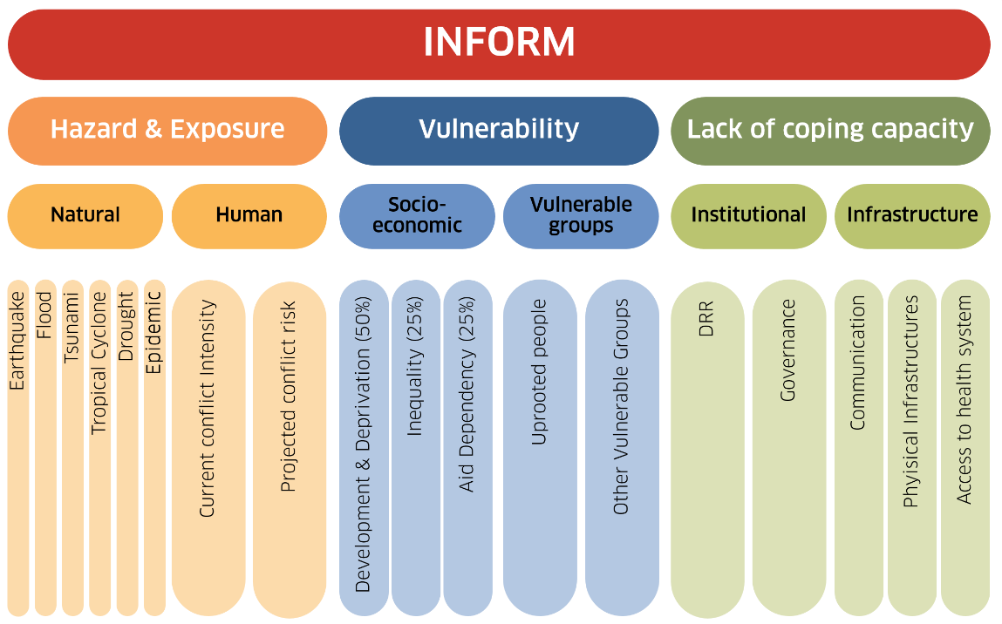
Introduction
INFORM is a public forum based in the European Union (EU) that shares analysis regarding various crisis and disasters for humanitarian relief. It’s main product, INFORM RISK, is a generalization of specific areas and their risk of a crisis based on a spectrum of factors pertaining to structural conditions. It is used to help in risk reduction as well as crisis prevention and preparedness. This dataset focuses on the cities in eastern African countries.
Source: https://drmkc.jrc.ec.europa.eu/inform-index

Slide 3


Attributes
Country Human
Physical exposure to flood Hazard
Physical exposure to drought Development & Deprivation
Natural Inequality
Political Violence
Conflict Probability

Slide 4
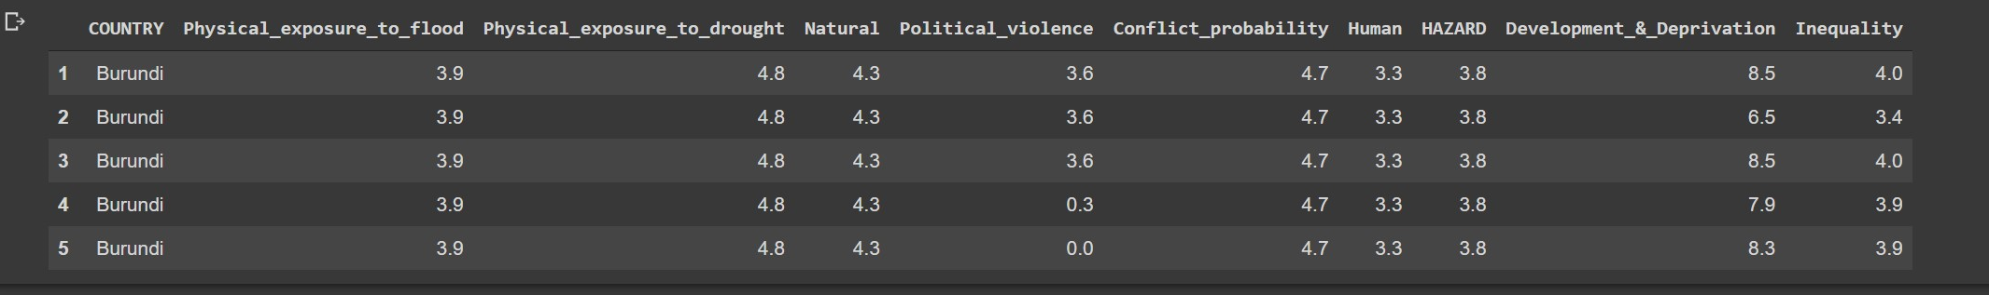

Slide 5
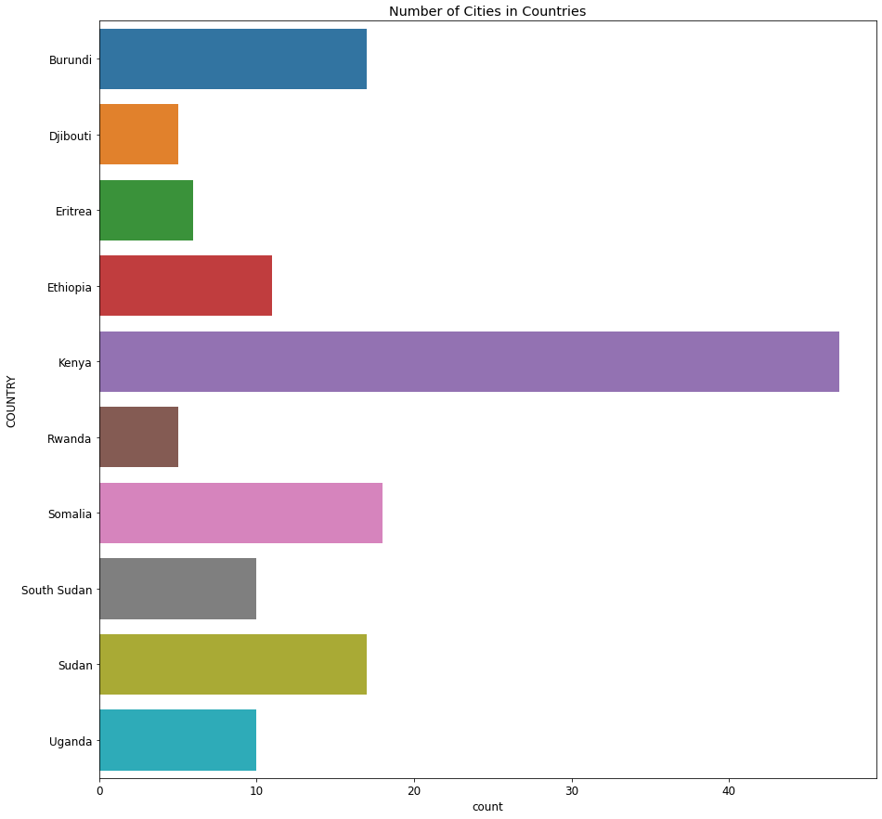
Exploratory Data Analysis (EDA)
CITIES/towns IN countries
stats
There are 10 countries in the data set.
Kenya has the most amount of cities/towns
Rwanda and Djibouti are tied for least amount of cities/towns

Slide 6
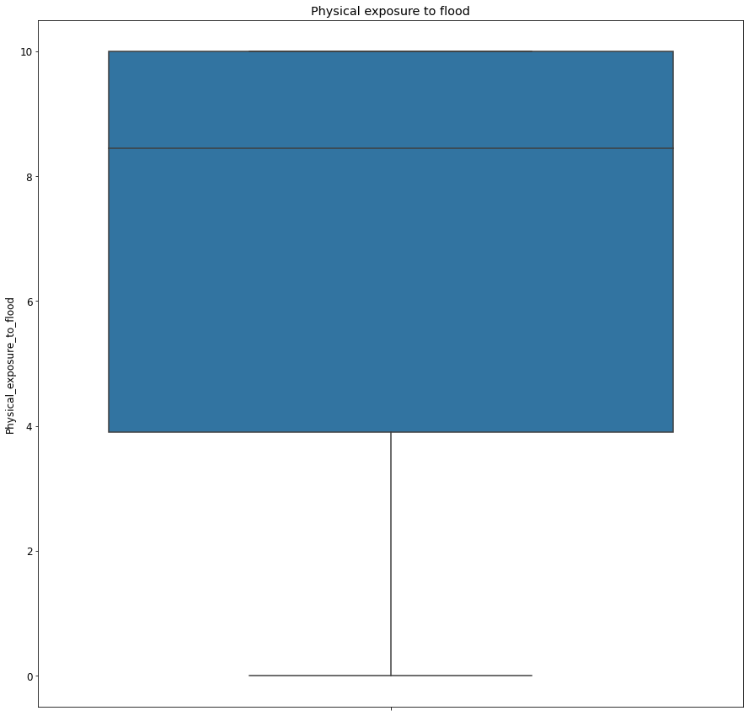
Exploratory Data Analysis (EDA)
PHYSICAL exposure TO FLOODS
stats
Mean: 7.063699
Majority of cities are between 4 and 10 on the Overall Risk Index
Max value is 10
Min value is 0

Slide 7
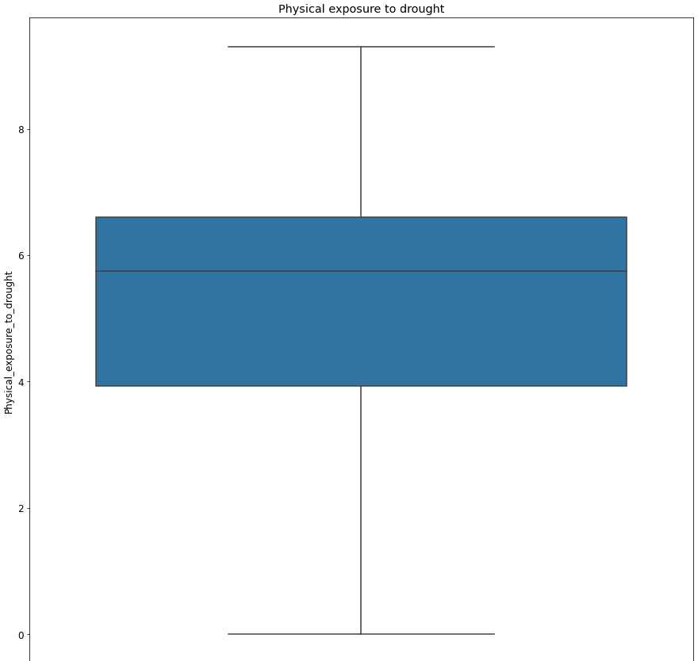
Exploratory Data Analysis (EDA)
PHYSICAL exposure TO drought
stats
Mean: 5.039726
Majority of cities are between 4 and 7 on the Overall Risk Index
Max value is 9.3
Min value is 0

Slide 8
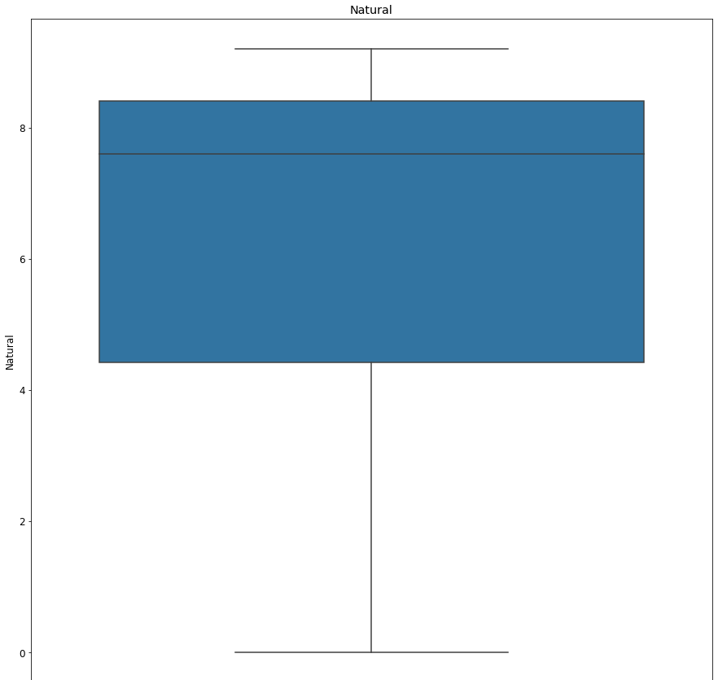
Exploratory Data Analysis (EDA)
Natural
stats
Mean: 6.594521
Majority of cities are between 4 and 8.5 on the Overall Risk Index
Max value is 9.2
Min value is 0

Slide 9
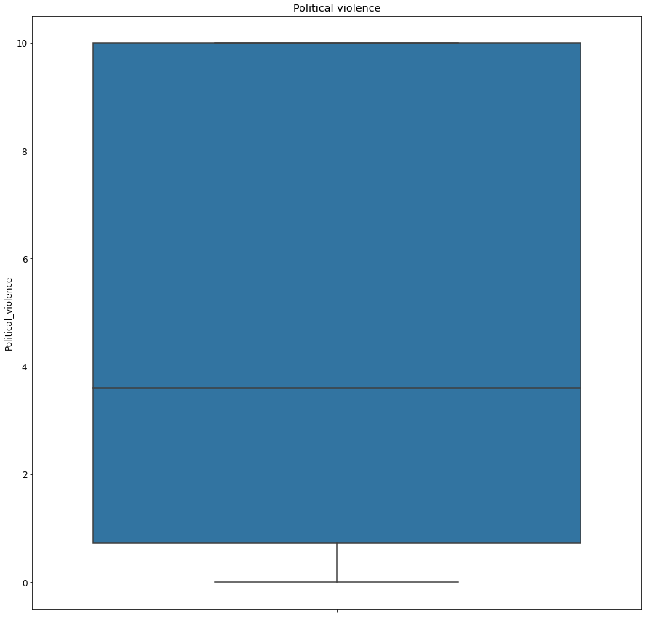
Exploratory Data Analysis (EDA)
Political Violence
stats
Mean: 4.851370
Majority of cities are between 4 and 8.5 on the Overall Risk Index
Max value is 9.2
Min value is 0

Slide 10
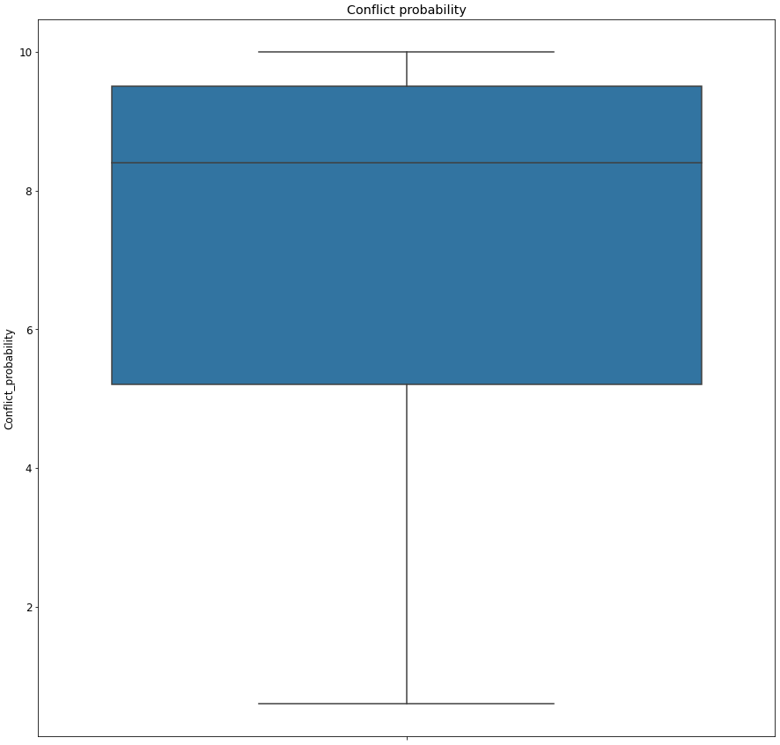
Exploratory Data Analysis (EDA)
Conflict Probability
stats
Mean: 7.331507
Majority of cities are between 5.2 and 9.5 on the Overall Risk Index
Max value is 10
Min value is 0.6

Slide 11
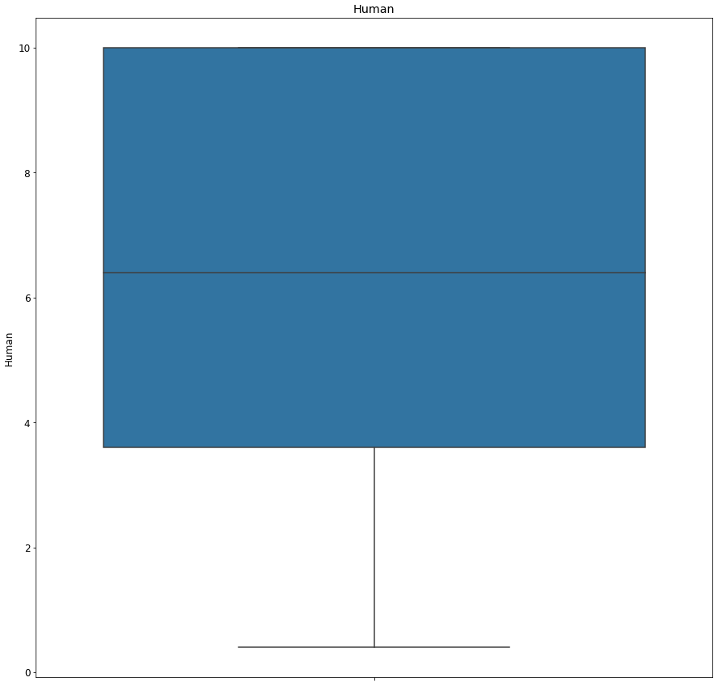
Exploratory Data Analysis (EDA)
Human (Crime)
stats
Mean: 6.306849
Majority of cities are between 3.6 and 10 on the Overall Risk Index
Max value is 10
Min value is 0.4

Slide 12
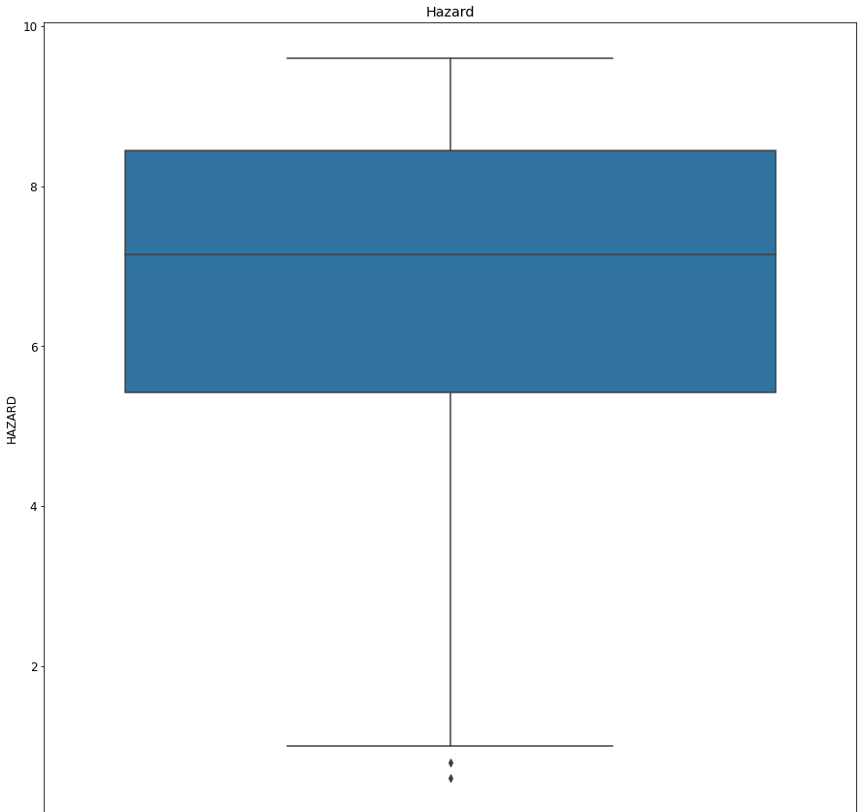
Exploratory Data Analysis (EDA)
Hazard
stats
Mean: 6.673288
Majority of cities are between 5.4 and 8.4 on the Overall Risk Index
Max value is 9.6
Min value is 0.6

Slide 13
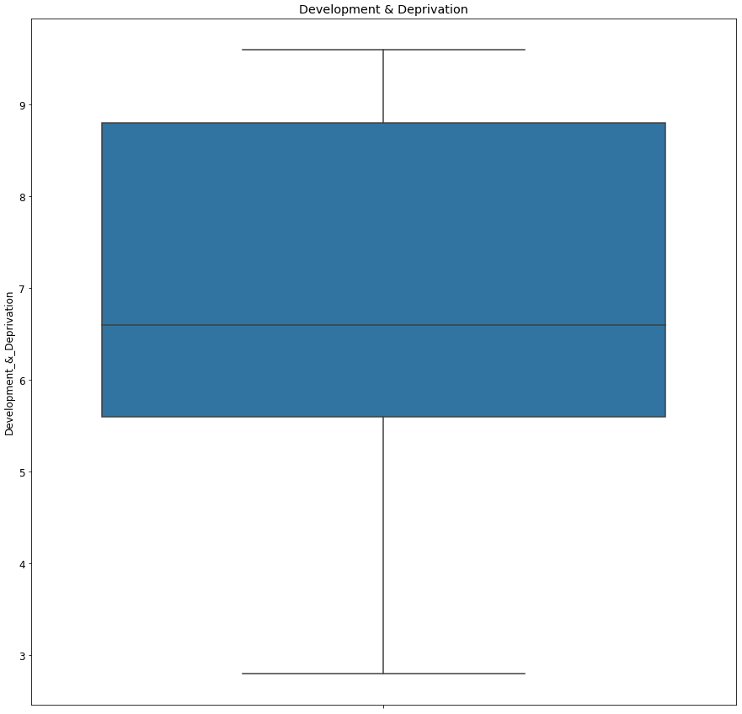
Exploratory Data Analysis (EDA)
Development & Deprivation
stats
Mean: 7.034932
Majority of cities are between 5.4 and 8.4 on the Overall Risk Index
Max value is 9.6
Min value is 0.6

Slide 14
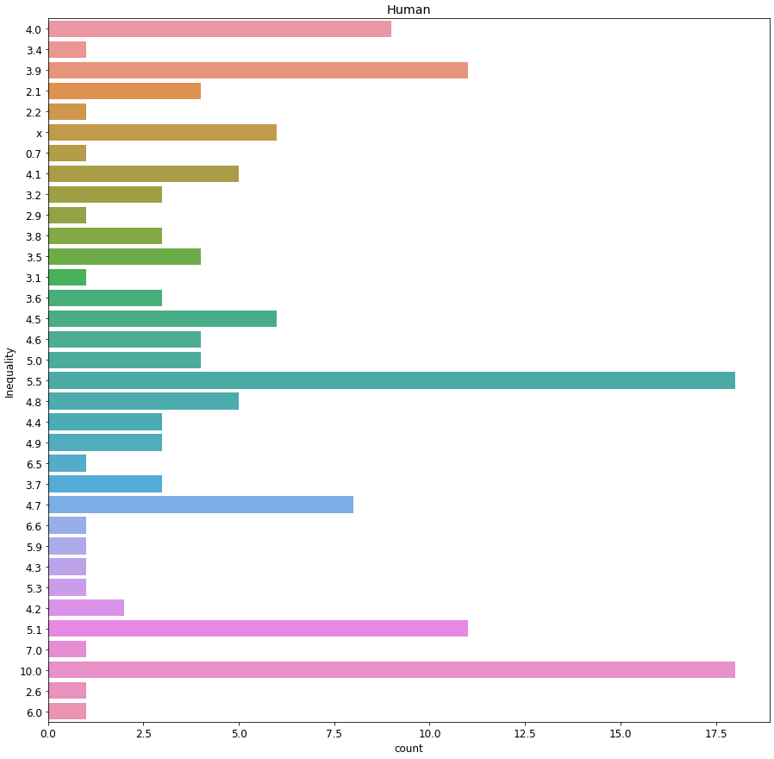
Exploratory Data Analysis (EDA)
Development & Deprivation
stats
Mean: N/A
Data is saved as an object instead of float due to an 'x' being present in this column

Slide 15
Data Cleaning

Slide 16

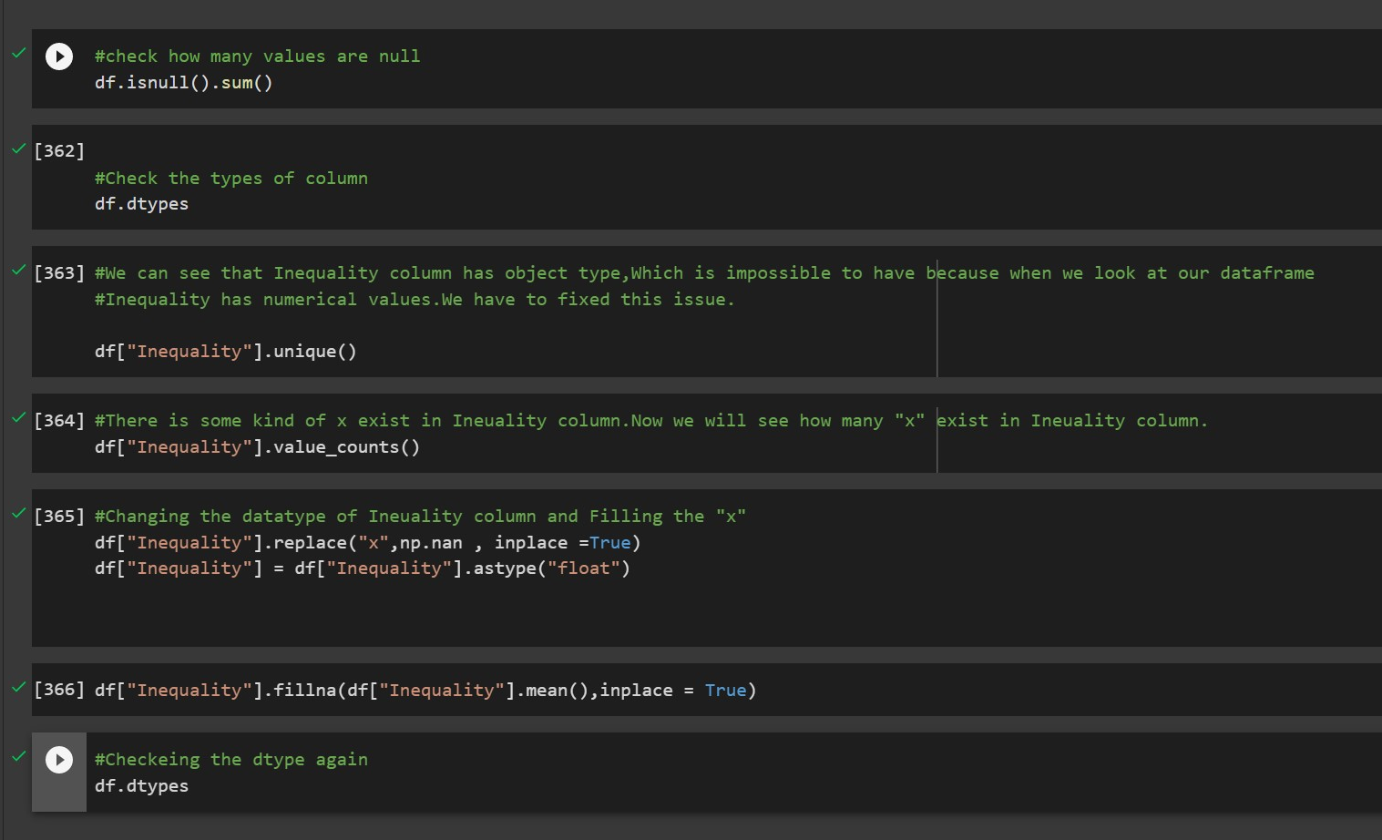

Slide 17
Handling Categorical Data

Slide 18
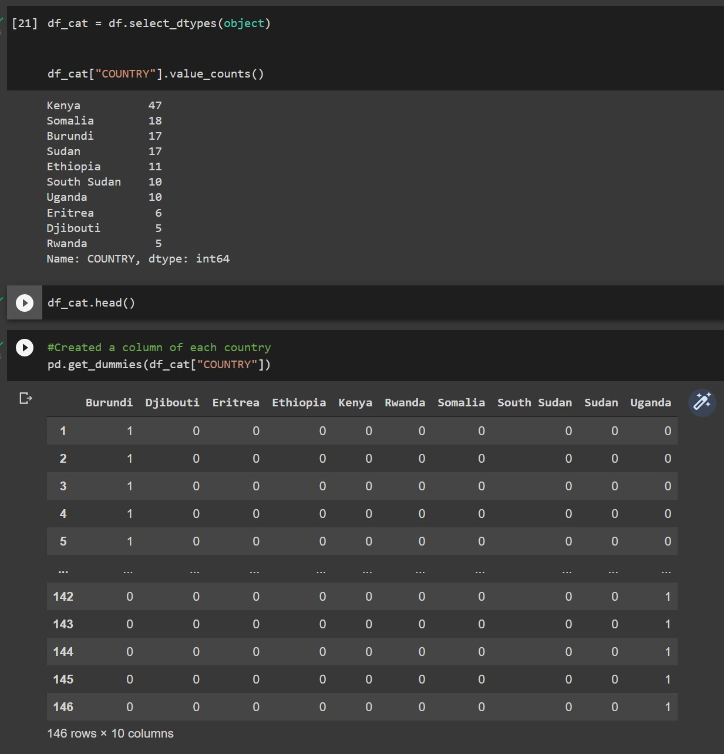
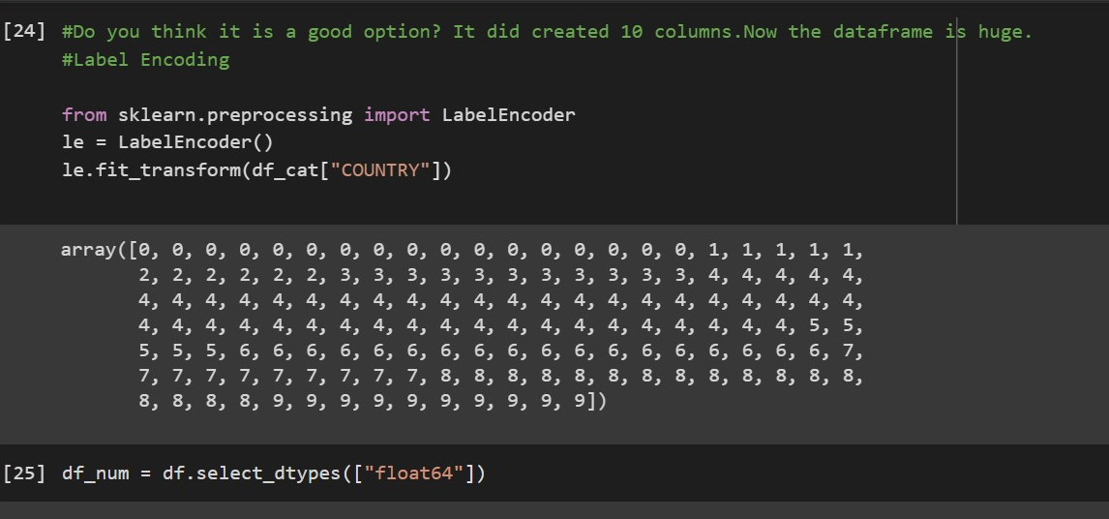

Slide 19
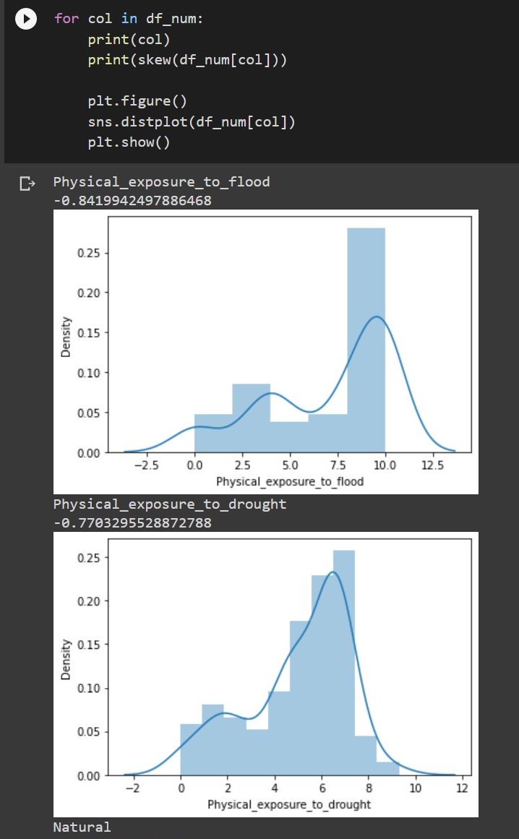
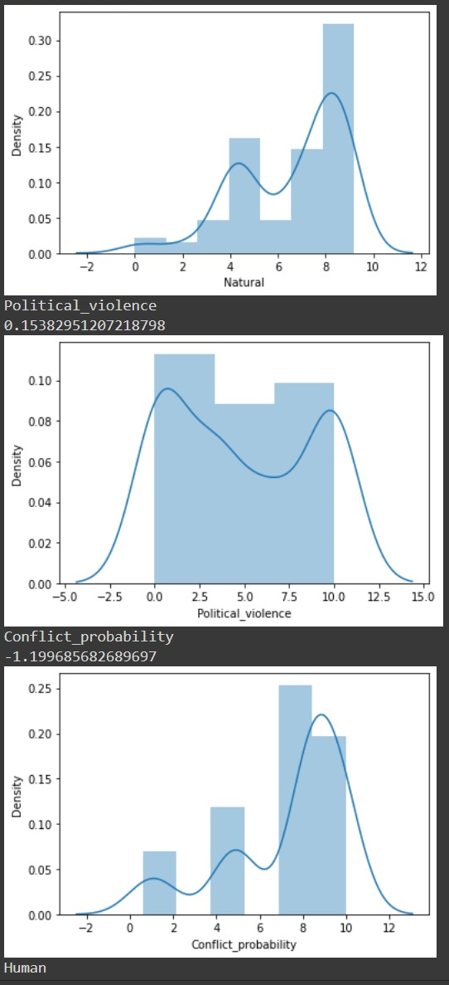
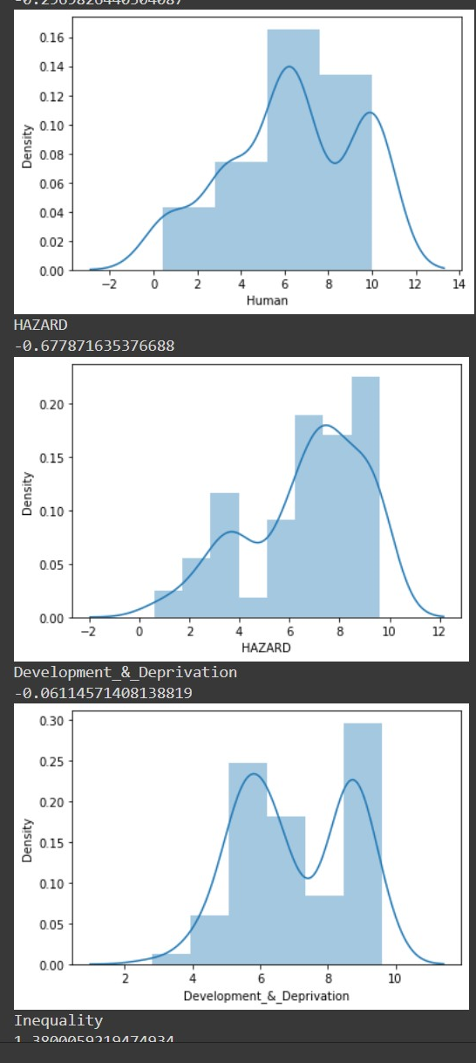

Slide 20
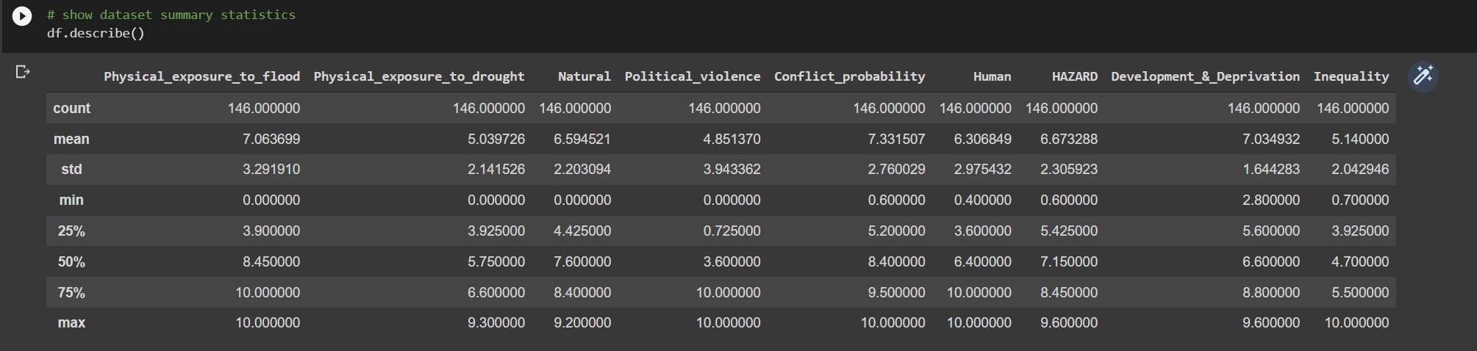

Slide 21
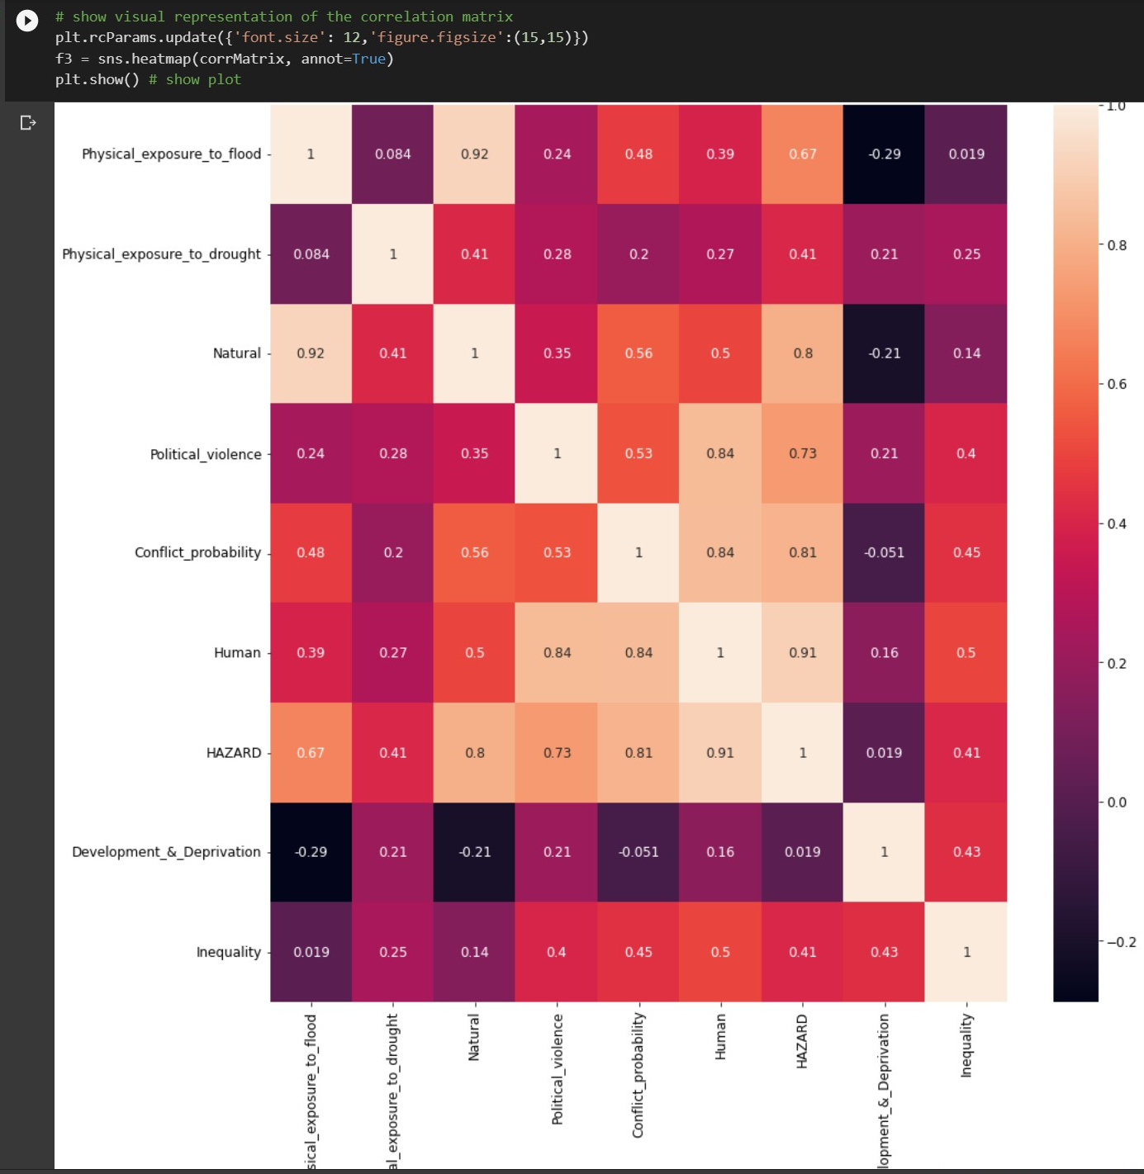

Slide 22
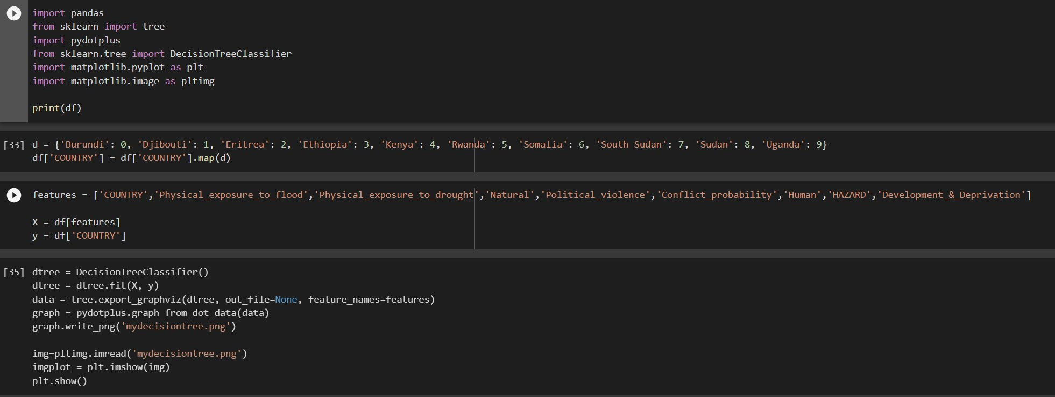

Slide 23
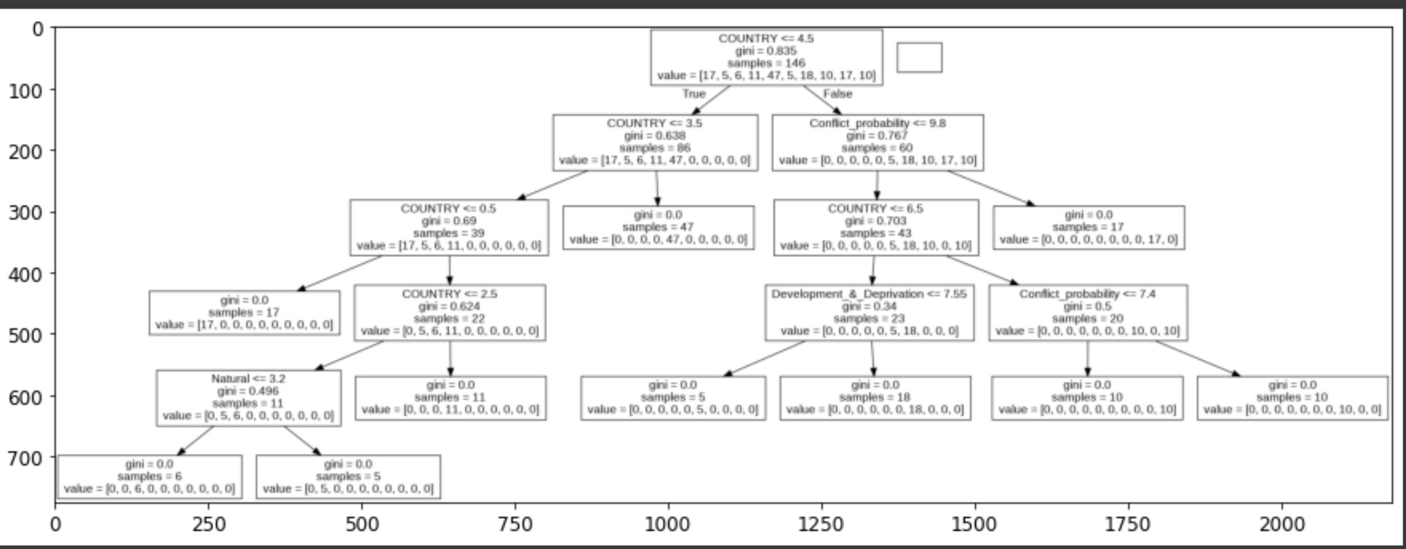

Slide 24
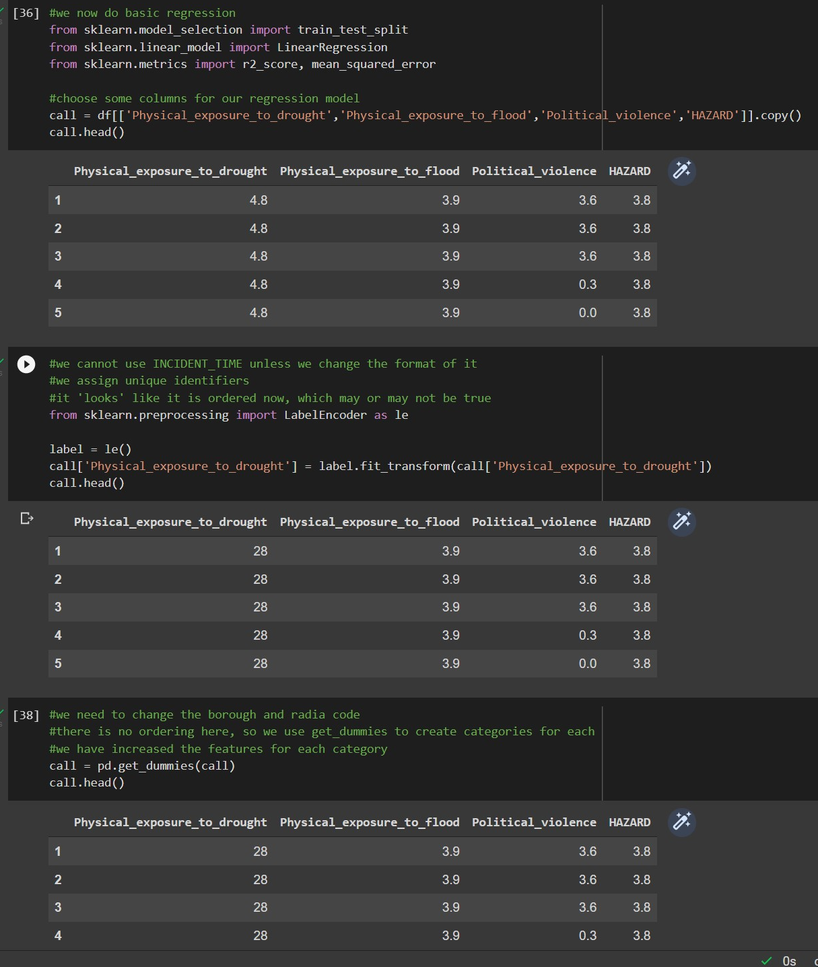

Slide 25
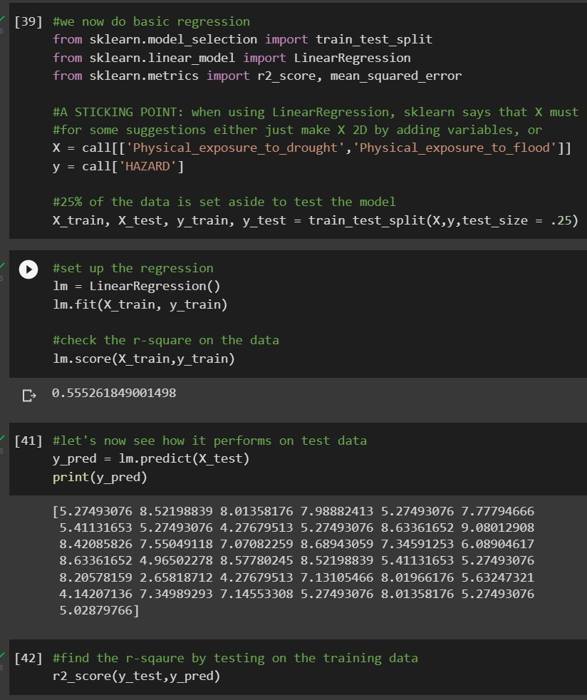

Slide 26
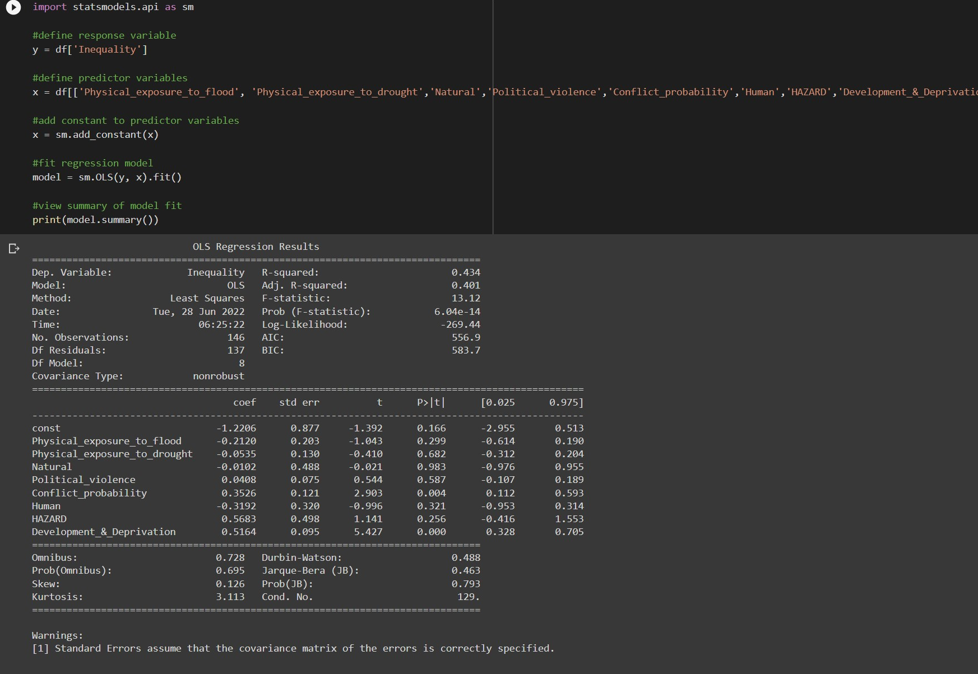

Slide 27
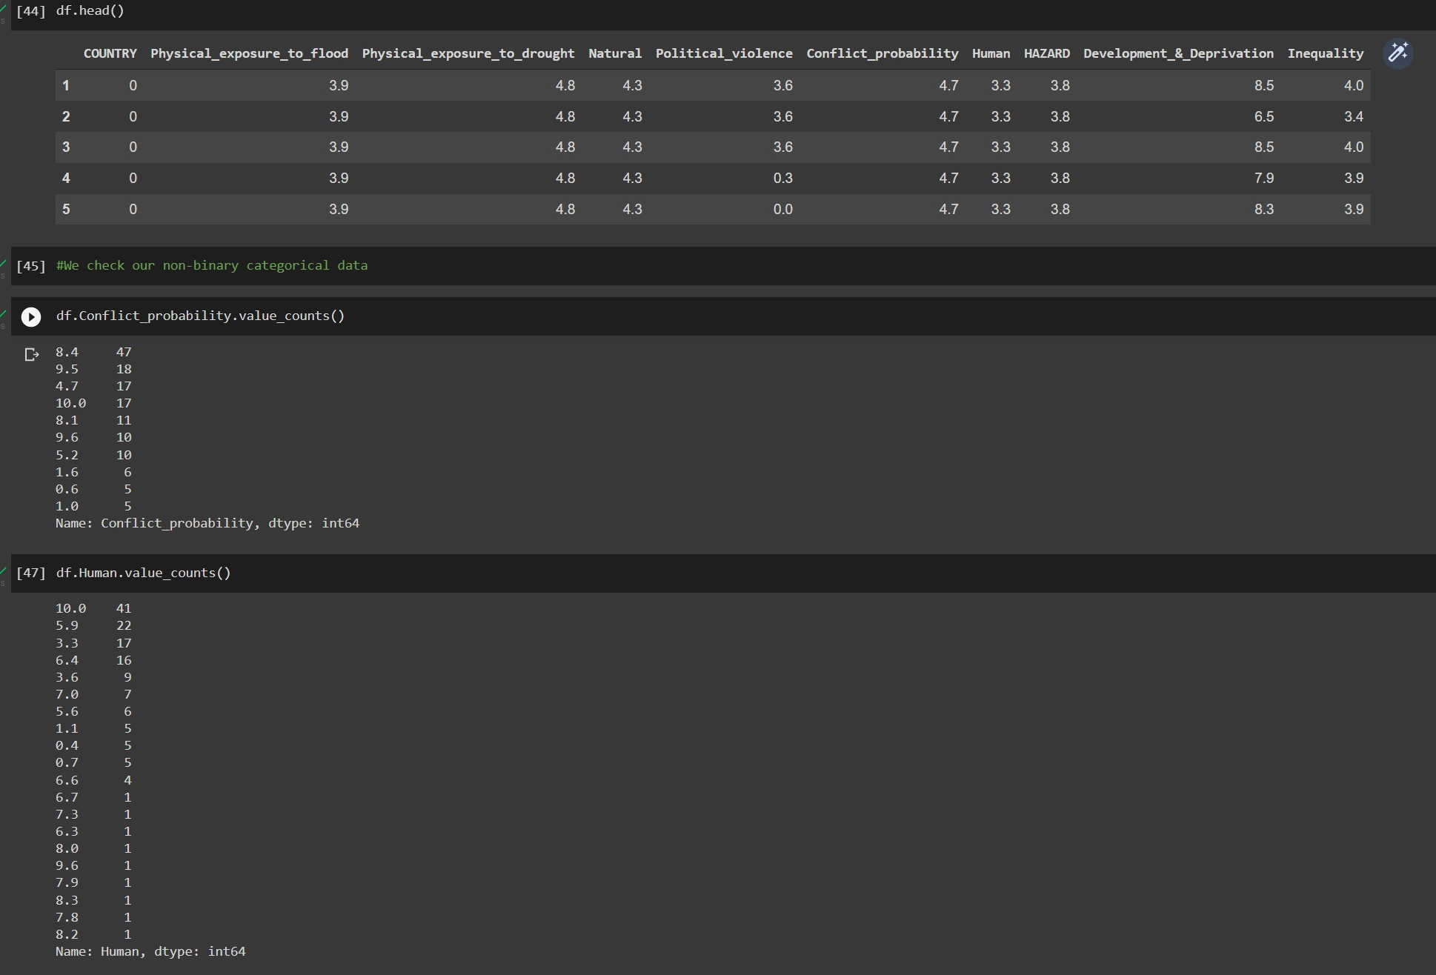

Slide 28
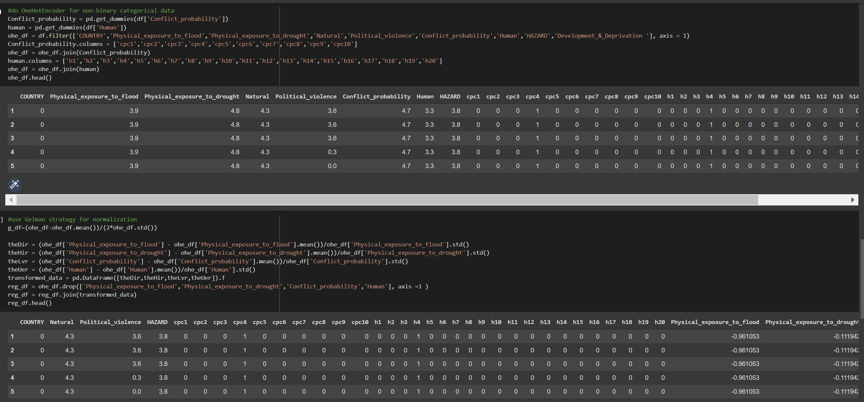

Slide 29
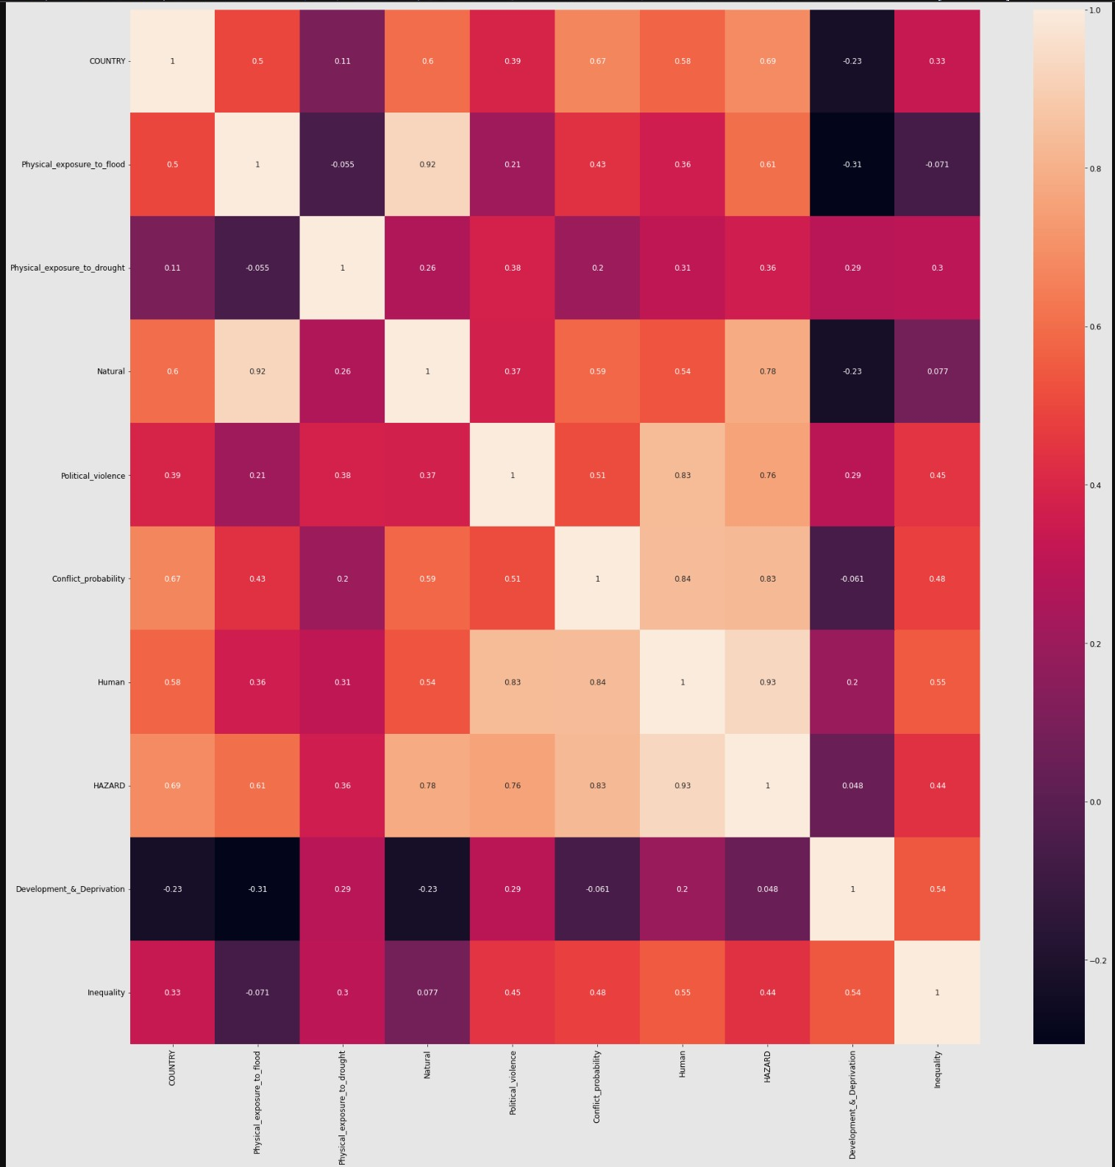
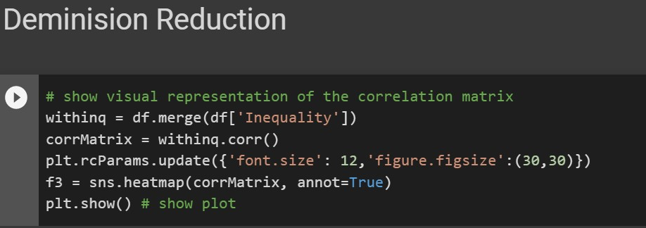

Slide 30
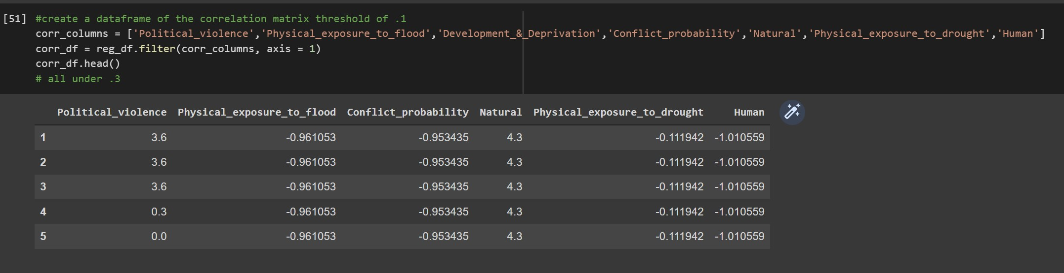

Slide 31
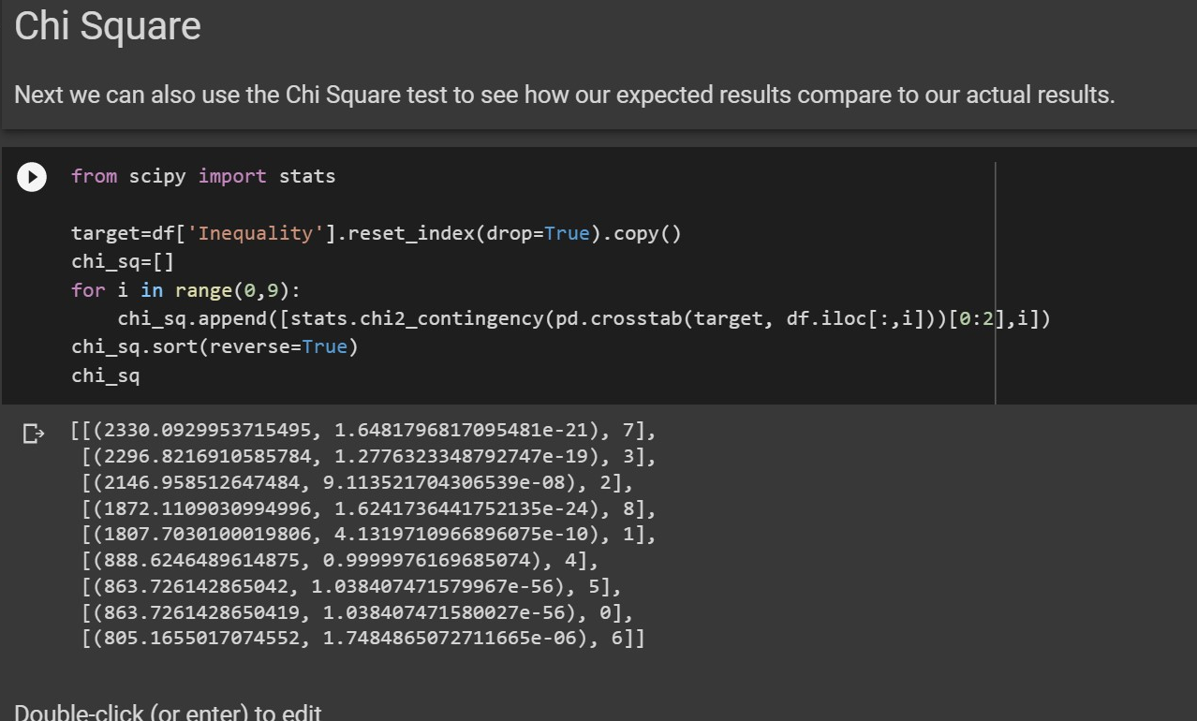

Slide 32
